Slide 1
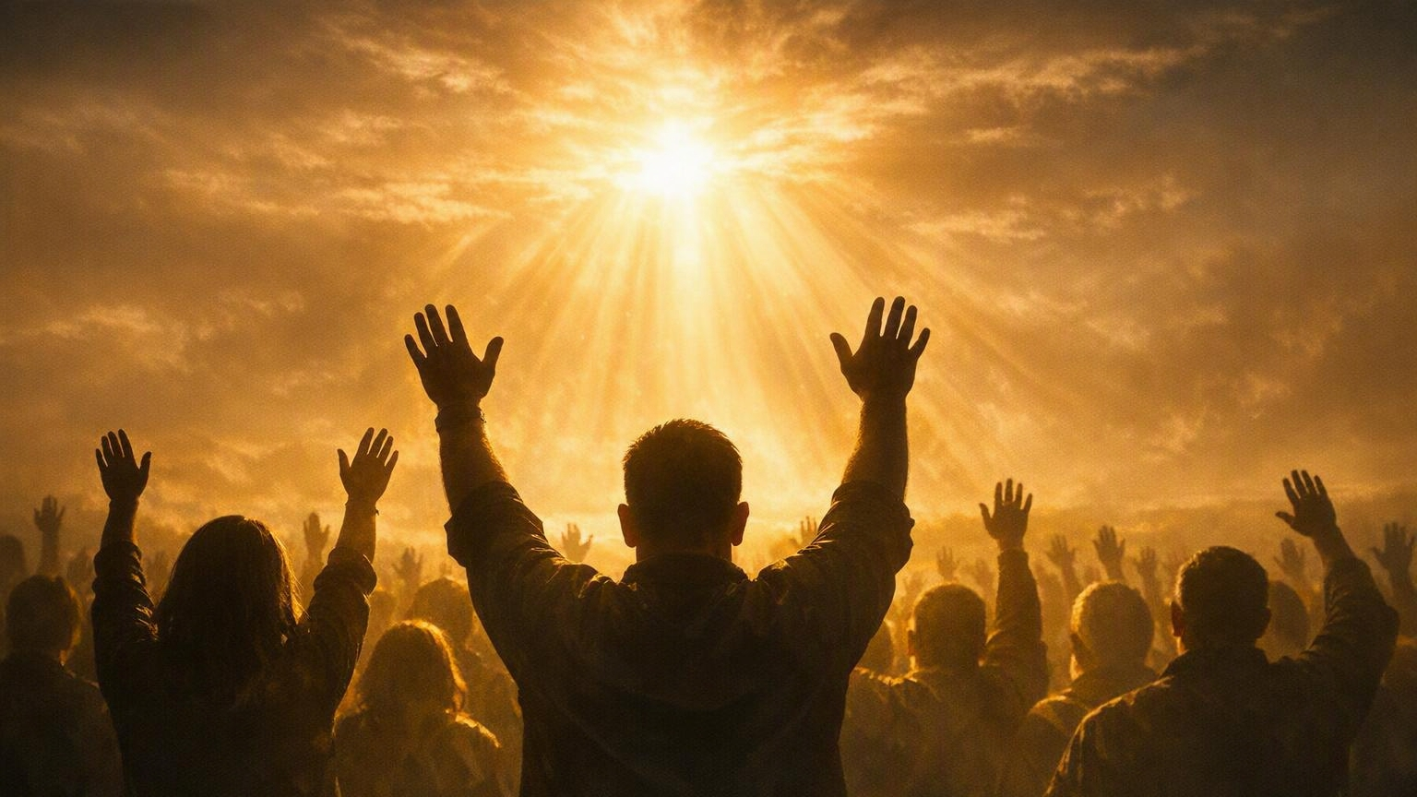
Why I Believe God Commands and Deserves the Very Best (First Fruit) of My Entire Christian Life
I Corinthians 10:31-33
Notes:
Eddie Williams`~ July 19, 2026

Slide 2
I Corinthians 10:31-33 (NASB)
³¹ Therefore, whether you eat or drink, or whatever you do, do all things for the glory of God. ³² Do not offend Jews or Greeks, or the church of God; ³³ just as I also please everyone in all things, not seeking my own benefit but the benefit of the many, so that they may be saved.

Slide 3
To Glorify:
Acknowledge
Honor
Reflect
Magnify
Give Credit To

Slide 4
1 Corinthians 10:31 States: "So, whether you eat or drink, or whatever you do, do all to the glory of God." It establishes the ultimate Christian standard: aligning every daily action—even basic tasks like eating—with the honor and praise of God.

Slide 5
The principle of doing all things for God's glory connects to several other passages throughout scripture.

Slide 6
The Christian Conduct Standard (Colossians 3:17):
Paul echoes this exact principle, stating that whatever you do in word or deed, it should be done in the name of the Lord Jesus, giving thanks to God.

Slide 7
Colossians 3:23 Adds an emphasis on daily labor, commanding that whatever you do should be done heartily, as working for the Lord rather than for men.

Slide 8
God Gave His Very Best for
Eddie Larry Williams

Slide 9
Romans 8:32 (NASB)
He who did not spare His own Son, but delivered Him over for us all, how will He not also with Him freely give us all things?

Slide 10
Romans 5:8 (NASB)
But God demonstrates His own love toward us, in that while we were still sinners, Christ died for us.

Slide 11
John 3:16 (NASB)
"For God so loved the world, that He gave His only Son, so that everyone who believes in Him will not perish, but have eternal life.

Slide 12
Hebrews 12:2 (NASB)
looking only at Jesus, the originator and perfecter of the faith, who for the joy set before Him endured the cross, despising the shame, and has sat down at the right hand of the throne of God.

Slide 13
God Wants Me to be Like Jesus, His Son, and Follow in His Footsteps

Slide 14
I Peter 2:21 (NASB)
For you have been called for this purpose, because Christ also suffered for you, leaving you an example, so that you would follow in His steps,

Slide 15
I John 2:6 (NASB)
the one who says that he remains in Him ought, himself also, to walk just as He walked.

Slide 16
Colossians 2:6 (NASB)
Therefore, as you have received Christ Jesus the Lord, so walk in Him,

Slide 17
I Corinthians 11:1 (NASB)
Be imitators of me, just as I also am of Christ.

Slide 18
Galatians 4:19 (NASB)
My children, with whom I am again in labor until Christ is formed in you

Slide 19
Philippians 2:5-14 (NASB)
⁵ Have this attitude in yourselves which was also in Christ Jesus, ⁶ who, as He already existed in the form of God, did not consider equality with God something to be grasped, ⁷ but emptied Himself by taking the form of a bond-servant and being born in the likeness of men.

Slide 20
Philippians 2:5-14 (NASB)
⁸ And being found in appearance as a man, He humbled Himself by becoming obedient to the point of death: death on a cross. ⁹ For this reason also God highly exalted Him, and bestowed on Him the name which is above every name,

Slide 21
Philippians 2:5-14 (NASB)
¹⁰ so that at the name of Jesus EVERY KNEE WILL BOW, of those who are in heaven and on earth and under the earth, ¹¹ and that every tongue will confess that Jesus Christ is Lord, to the glory of God the Father.

Slide 22
Philippians 2:5-14 (NASB)
¹² So then, my beloved, just as you have always obeyed, not as in my presence only, but now much more in my absence, work out your own salvation with fear and trembling; ¹³ for it is God who is at work in you, both to desire and to work for His good pleasure.

Slide 23
Philippians 2:5-14 (NASB)
¹⁴ Do all things without complaining or arguments;

Slide 24
Almighty God Wants Me to Put Him First in My Life; Not Self, Not People, Not Money or Things of This World

Slide 25
Matthew 10:34-39 (NASB)
³⁴ "Do not think that I came to bring peace on the earth; I did not come to bring peace, but a sword.
³⁵ "For I came to TURN A MAN AGAINST HIS FATHER, AND A DAUGHTER AGAINST HER MOTHER, AND A DAUGHTER-IN-LAW AGAINST HER MOTHER-IN-LAW;

Slide 26
Matthew 10:34-39 (NASB)
³⁶ and A PERSON'S ENEMIES WILL BE THE MEMBERS OF HIS HOUSEHOLD.
³⁷ "The one who loves father or mother more than Me is not worthy of Me; and the one who loves son or daughter more than Me is not worthy of Me.

Slide 27
Matthew 10:34-39 (NASB)
³⁸ "And the one who does not take his cross and follow after Me is not worthy of Me.
³⁹ "The one who has found his life will lose it, and the one who has lost his life on My account will find it.

Slide 28
Matthew 6:34 (NASB)
"So do not worry about tomorrow; for tomorrow will worry about itself. Each day has enough trouble of its own.

Slide 29
Proverbs 3:5-6 (NASB)
⁵ Trust in the LORD with all your heart And do not lean on your own understanding. ⁶ In all your ways acknowledge Him, And He will make your paths straight.

Slide 30
I John 2:15-17 (NASB)
¹⁵ Do not love the world nor the things in the world. If anyone loves the world, the love of the Father is not in him. ¹⁶ For all that is in the world, the lust of the flesh and the lust of the eyes and the boastful pride of life, is not from the Father, but is from the world.

Slide 31
I John 2:15-17 (NASB)
¹⁷ The world is passing away and also its lusts; but the one who does the will of God continues to live forever.

Slide 32
Proverbs 3:9 (NASB) Honor the LORD from your wealth And from the first of all your produce;
Tithing is not taught directly in the New Testament. It was taught in the Law of Moses. The Israelites gave 23 1/3 % with two annual tithes and a triennial tithe (Num 18:20-32; Deut. 14:22-29).

Slide 33
Plus, they gave special vows and freewill offerings (Deut. 12:6). How did Abraham and Jacob know about tithing before the Law of Moses (Gen 14:20; 28:22)? Because it is a general rule of godly giving, which New Testament saints should use as a guide or minimum for the far greater blessings they enjoy (Luke 12:48; Heb 8:6).

Slide 34
God dares His people to test how much He can bless them (Mal 3:8-12). Abraham, Isaac, and Jacob were financially blessed, because they knew how to give (Gen 14:20; 28:22). God made David rich (I Chron 29:18), but David loved to give (I Chron 21:24; 22:1-16). If you give liberally, the Lord promises to reward you liberally (Pr 11:25; Luke 6:38).

Slide 35
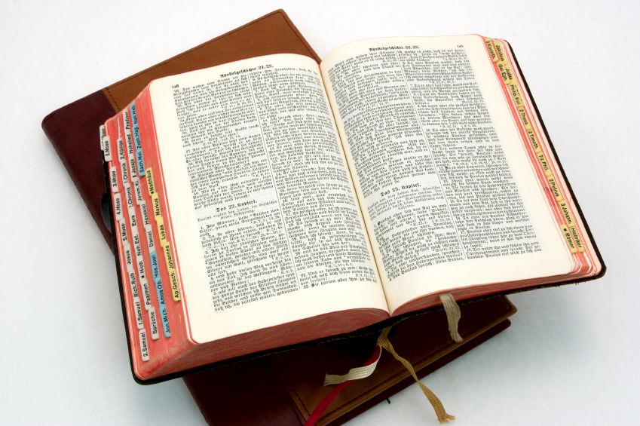
Hear: Romans 10:17
So then faith cometh by hearing, and hearing by the word of God.

Slide 36
Believe: Hebrews 11:6
But without faith it is impossible to please him: for he that cometh to God must believe that he is, and that he is a rewarder of them that diligently seek him.

Slide 37
Repent: Luke 13:3
I tell you, Nay: but, except ye repent, ye shall all likewise perish.

Slide 38
Confess: Matthew 10:32-33
32 Whosoever therefore shall confess me before men, him will I confess also before my Father which is in heaven.
33 But whosoever shall deny me before men, him will I also deny before my Father which is in heaven.

Slide 39
Baptize: Acts 22:16
And now why tarriest thou? arise, and be baptized, and wash away thy sins, calling on the name of the Lord.

